Slide 1
CIS 565 CUDA Debugging Lab
Shehzan Mohammed
@shehzanm

Slide 2
Today’s List
Debugging Tools
Visual Studio Debugger
Nsight Debugger
Write and Debug Kernels
Notes:
Incorrect launch configuration
ThreadIdx / BlockIdx
Syncthreads
Atomic

Slide 3
Debugging in Practice
Showing tools I use
printf(“%s : %d => I am here\n”, __FILE__, __LINE__);
Visual Studio Debugger
And it’s limitations for GPU Programming
Nsight Debugging

Slide 4
Debugging Tools
Host Side
Visual Studio Debugger
GDB
Device Side
Nsight Visual Studio Edition
Nsight Eclipse Edition
cuda-gdb
printf

Slide 5
How Much Debugging Do We Know?
printf/cout/fstream
Breakpoint & Conditional Breakpoints
Call stack
Autos/Locals/Watch

Slide 6
CUDA Tools
Debugging : Nsight / CUDA GDB
Profiling : NV Visual Profiler, Nsight
Runtime : CUDA Occupancy Calculator

Slide 7
CUDA GDB (Linux)
CUDA-GDB
An extension of GDB
Allows you to debug on actual hardware
Can debug CPU and GPU code
Compile using the -g and the -G flags
Includes debug info
nvcc -g -G foo.cu -o foo
Usage of cuda-gdb is similar to gdb
For more information, shoot me an email!

Slide 8
Debugging Coordinates
Software Coordinates
Thread
Block
Kernel
Hardware Coordinates
Lane (thread)
Warp
SM
Device

Slide 9
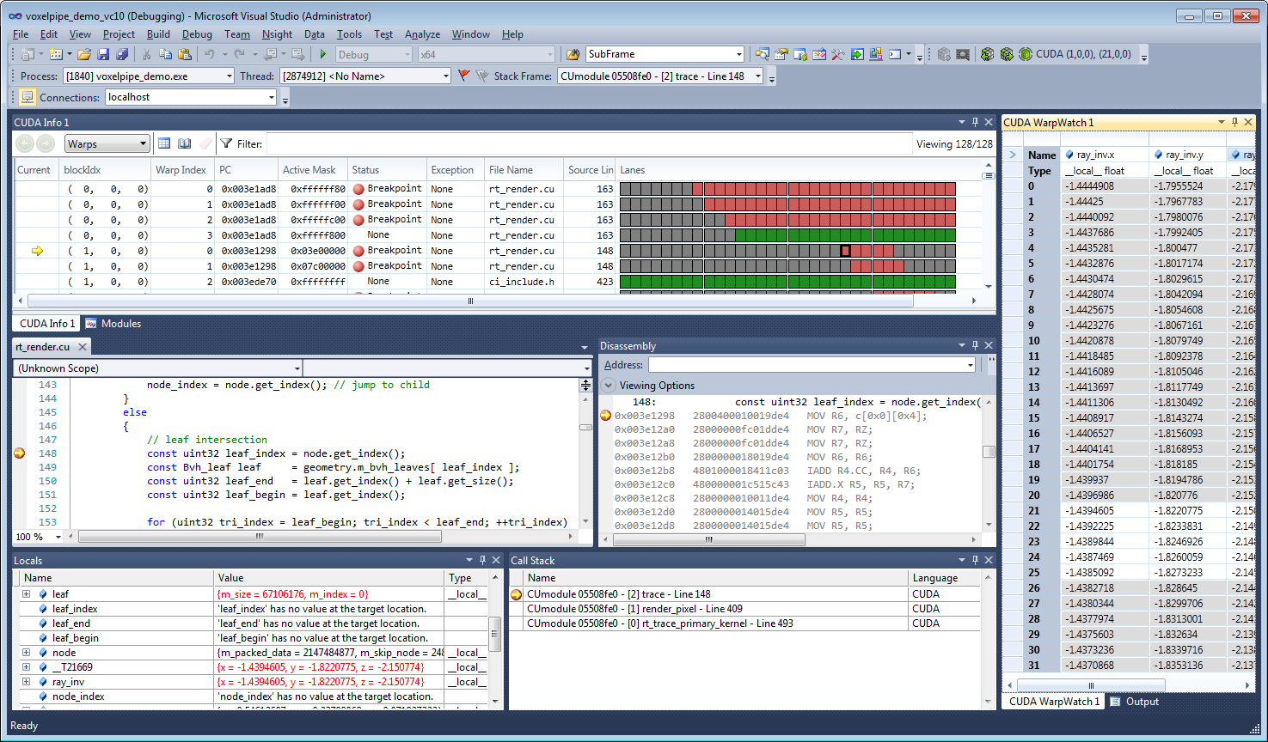
Nsight Visual Studio Edition

Slide 10
So what can Nsight do?
Comprehensive debugging and profiling tool
Contents:
GPU Debugger
Graphics Inspector
System Profiling
More information than you know what to do with
Nsight Visual Studio Edition User Guide
Nsight Eclipse Edition User Guide

Slide 11
GPU Debugging
CUDA Debugger
CUDA Memcheck
CUDA Profiling
Trace

Slide 12
Matrix Transpose
Transpose is a great place CUDA Programming
It uses all the basics
But also has performance improvements
Easy to go wrong too
1 | 2 | 3 | 4
5 | 6 | 7 | 8
9 | 10 | 11 | 12
13 | 14 | 15 | 16
1 | 5 | 9 | 13
2 | 6 | 10 | 14
3 | 7 | 11 | 15
4 | 8 | 12 | 16

Slide 13
Matrix Transpose Copy
Let’s start with Matrix Copy
Compute i and j indices
Convert to 1D index
Copy
Did we take any shortcuts?
1 | 2 | 3 | 4
5 | 6 | 7 | 8
9 | 10 | 11 | 12
13 | 14 | 15 | 16
1 | 2 | 3 | 4
5 | 6 | 7 | 8
9 | 10 | 11 | 12
13 | 14 | 15 | 16
Notes:
Probably Shortcuts:
Assume square
multiple of 32 – did not check for out of bounds

Slide 14
Naïve Matrix Transpose
Similar to matrix copy
Except output index is transpose of input index
Compute i and j indices
Compute input index and output index
Do the transpose!

Slide 15
Matrix Transpose with Shared Memory
Shared memory can improve transpose performance
Will discuss in lectures & Performance Lab
Shared memory allocated statically
Compute index variables
Copy input to shared memory
Copy shared memory to output
What is the problem with this kernel/shared memory?
Shared Memory
1 | 2 | 3 | 4
5 | 6 | 7 | 8
9 | 10 | 11 | 12
13 | 14 | 15 | 16
1 | 5 | 9 | 13
2 | 6 | 10 | 14
3 | 7 | 11 | 15
4 | 8 | 12 | 16

Slide 16
Matrix Transpose with Dynamically Allocated Shared Memory
Static shared memory has significant limitations
CUDA allows host to set shared memory size
This size is per block and only 1D
Calculate shared memory required on host
Invoke the kernel with shared memory information
Do the transpose!
Almost same as static shared memory kernel

Slide 17
Matrix Transpose
What have we learnt?
What did we assume?
Notes:
Learnt:
2D Indexing -> 1D Indexing
Using shared memory as intermediate
Assumed:
Square
Size is multiple of launch configuration

Slide 18
Matrix Transpose – Non-squared
Change sizeX and sizeY to non-square values
Run transpose
What fails?
Debug!
Notes:
Fixes:
Add basic exit conditions to copy kernel and transpose
Shared Mem transpose: Add condition around shared memory copy and write

Slide 19
Matrix Transpose – Non-squared & Not 32 multiple
Change sizeX and sizeY to a number not a multiple of 32
Run transpose
What fails?
Notes:
Use divup throughout

Slide 20
Conclusion
Use Nsight for Debugging
Avoid printf in kernels
Use conditional break points
CUDA hands-on programming
Write and debug transpose
Consider non-uniform size
Use __syncthreads between shared memory write & read
Will learn about performance in Performance Lab (9/18)

Slide 21
Useful Links
CUDA Documentation: http://docs.nvidia.com/cuda/index.html
GTC On-Demand: http://on-demand-gtc.gputechconf.com/gtcnew/on-demand-gtc.php
CUDA Getting Started Windows: http://docs.nvidia.com/cuda/cuda-getting-started-guide-for-microsoft-windows/index.html
Google Style Guide C++: http://google-styleguide.googlecode.com/svn/trunk/cppguide.html
Demos and tutorials:
http://on-demand.gputechconf.com/gtc/2013/presentations/S3478-Debugging-CUDA-Kernel-Code.pdf
https://developer.nvidia.com/content/efficient-matrix-transpose-cuda-cc
http://developer.download.nvidia.com/compute/cuda/1.1-Beta/x86_website/projects/reduction/doc/reduction.pdf

Slide 22
Enable Debug Info (CMake Project)
CMake does it for you in debug mode
Otherwise…
Project -> Properties
C++ -> General -> Generate Debug Info
Linker -> Debugging Generate Debug Info -> Yes
Linker -> Optimization -> Enable CODMAT Folding -> Yes

Slide 23
Enable Debug Info (CUDA Project)
Turn on Debug Info
Project->Properties->CUDA C/C++->
Generate GPU Debug Info
Generate Host Debug Info
Set compute capability for your GPU

